Slide 1
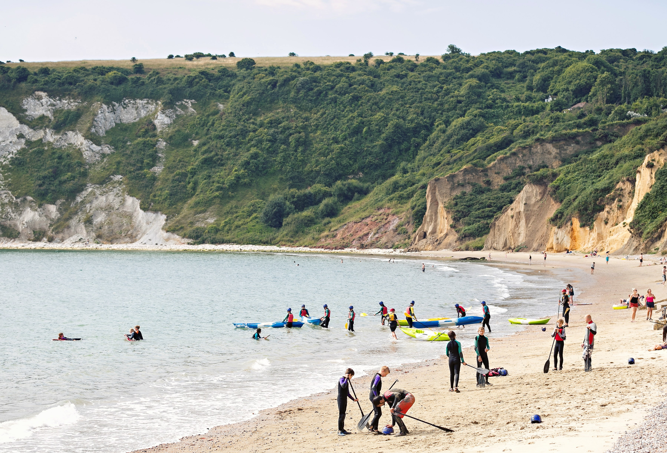
Isle of Wight (2023) 12th – 16th June 2023

Slide 2
What our children said about their visit
"I enjoyed the Isle of Wight because I got to spend time with my friends and solve my own problems!"
"I enjoyed the Isle of Wight because we got to be completely independent with our friends!"

Slide 3
https://www.youtube.com/watch?v=V88O41d5Ghg

Slide 4
Intended Outcomes: Personal Development

Slide 5
Gaining independence in performing specific skills

Slide 6
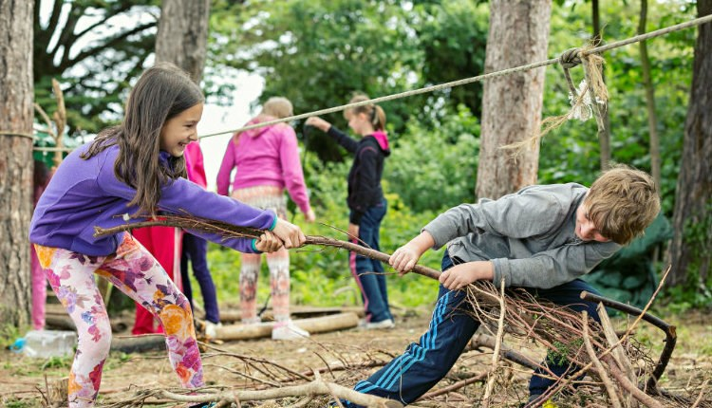
Developing resilience and learning a range of strategies to help them problem solve

Slide 7
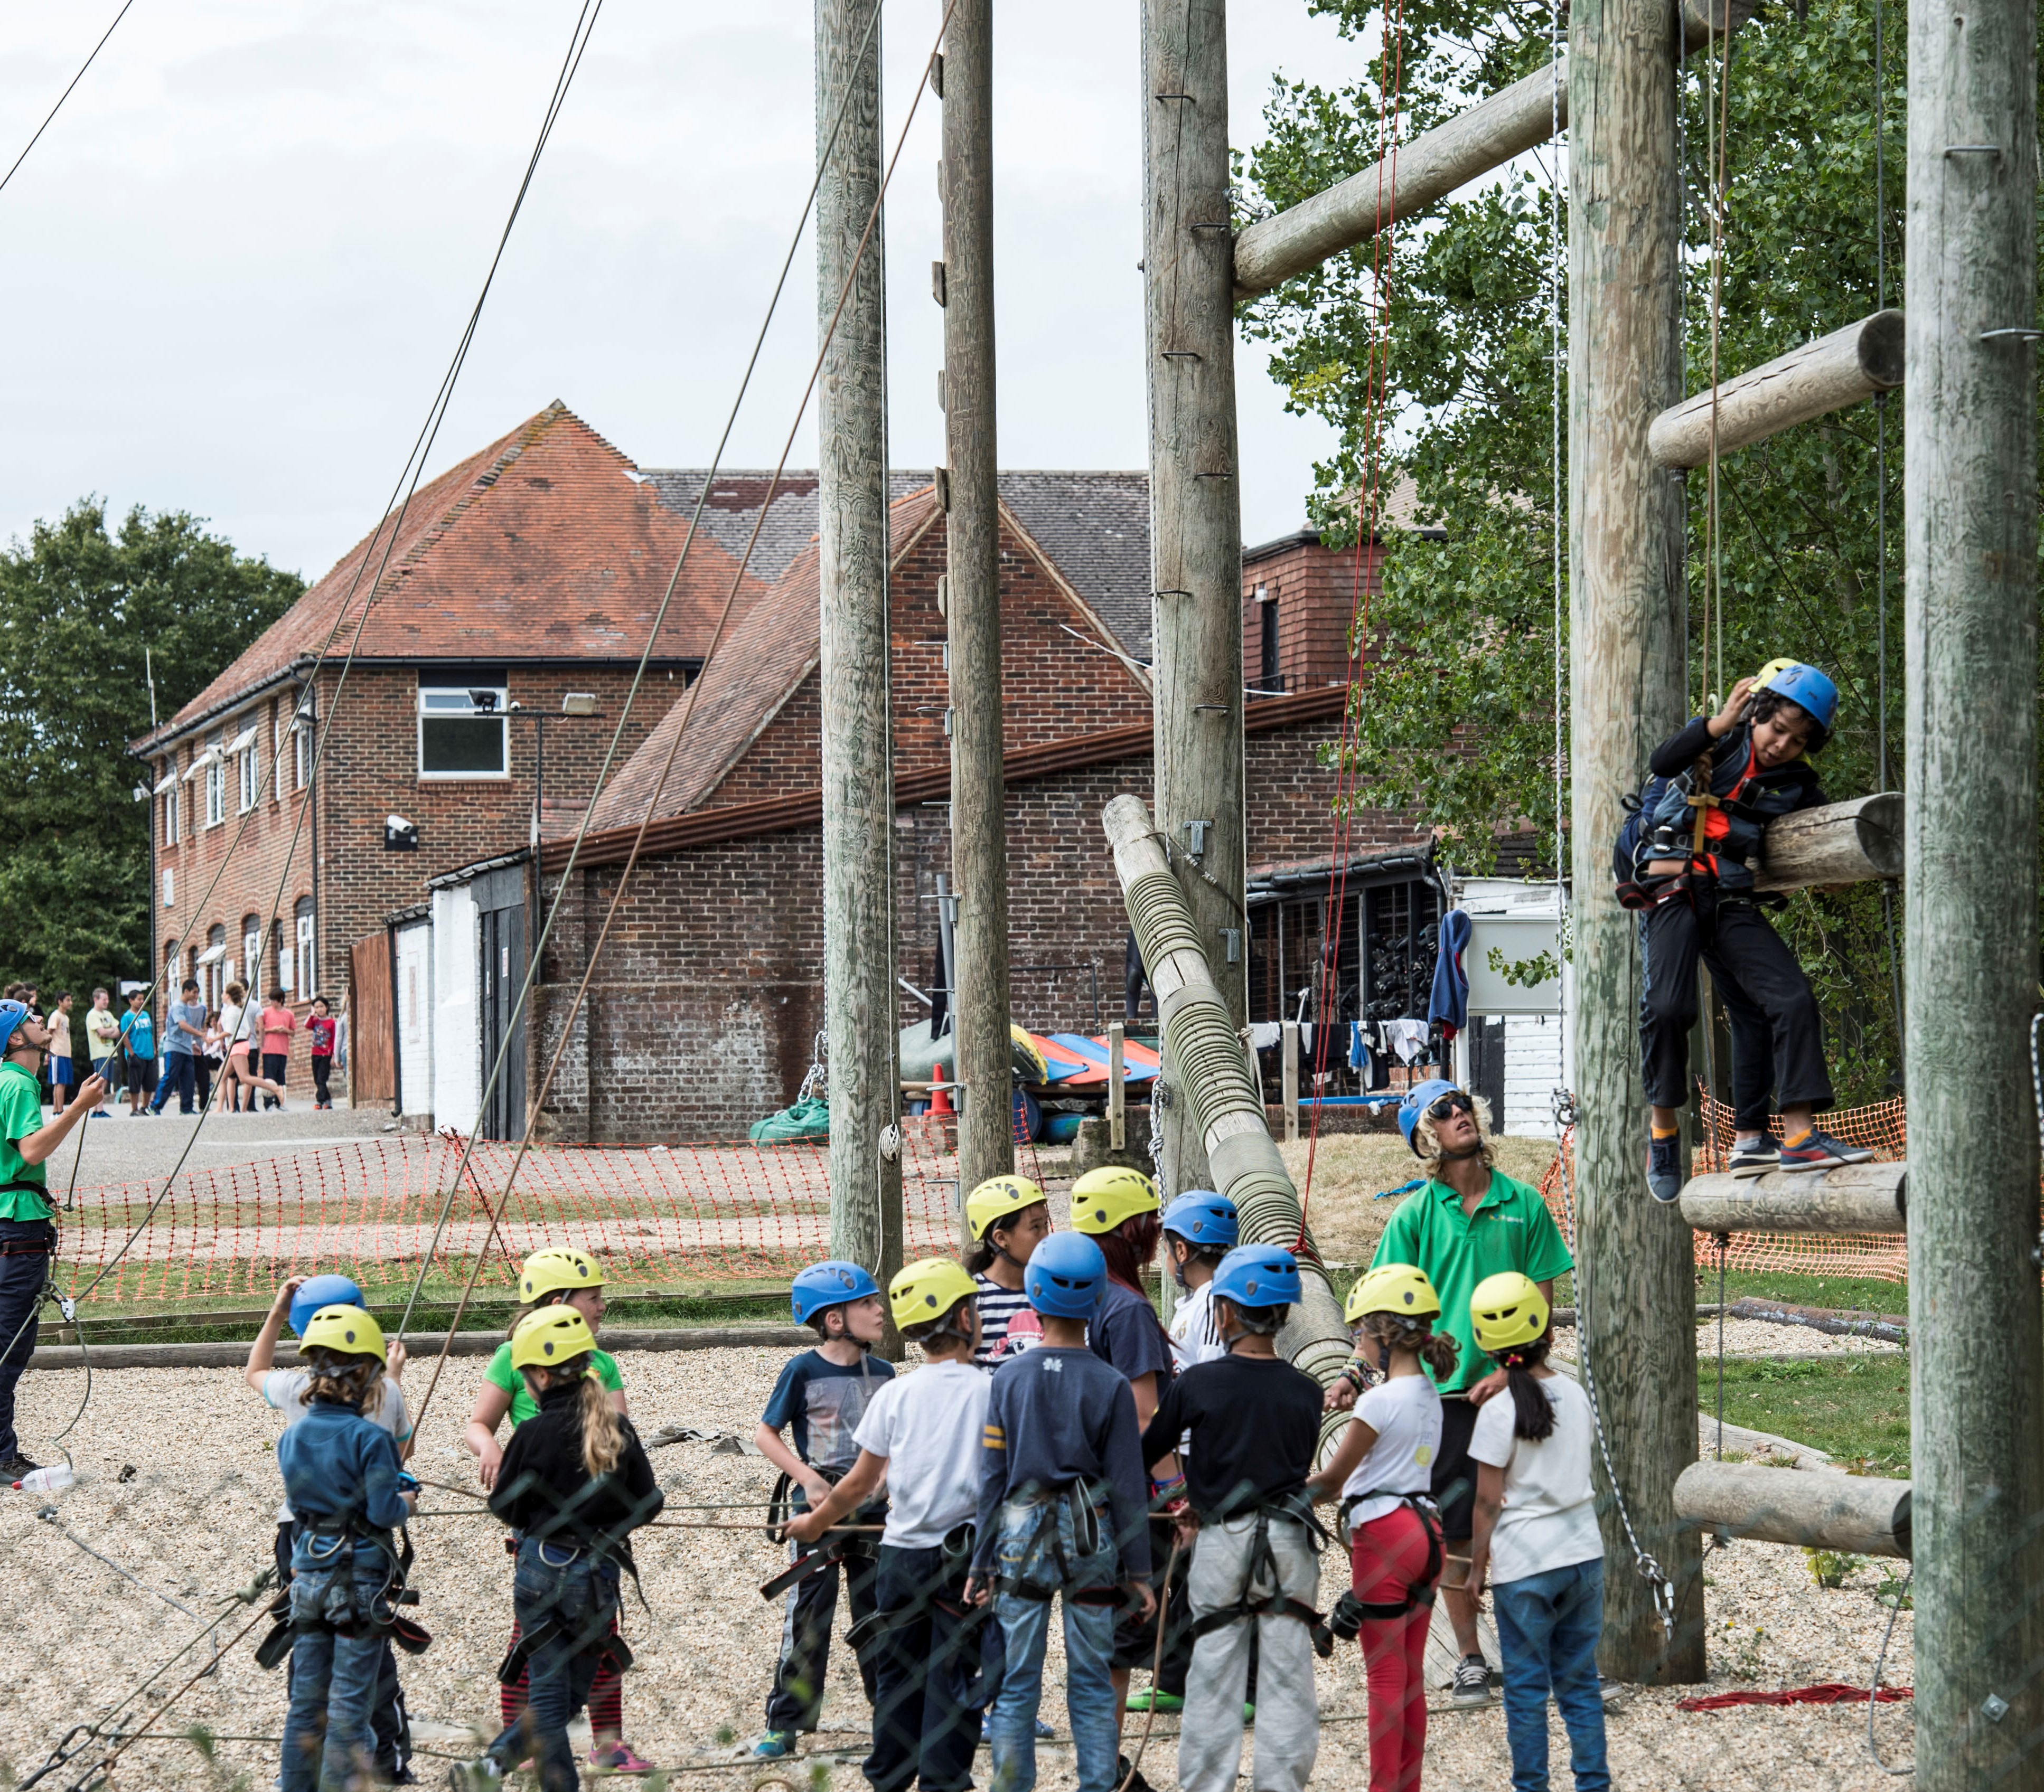
Learning to work collaboratively and develop self-confidence

Slide 8
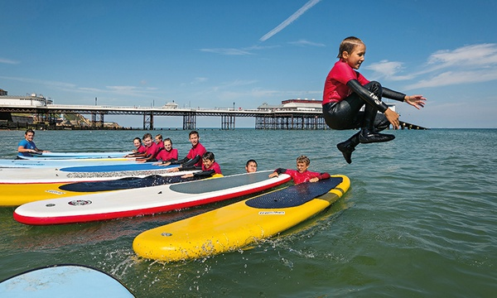
Creating memories that will last a lifetime!

Slide 9
Who is going?

Slide 10
Rooms

Slide 12
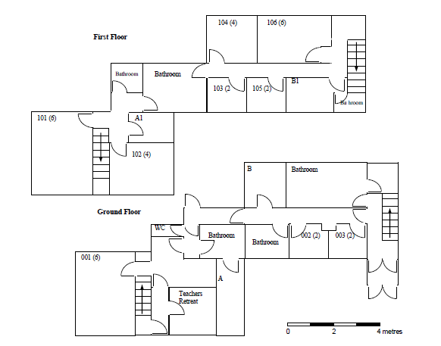

Slide 13
Activities
Nightline
Sea Kayaking
Body boarding
Abseiling
Orienteering
3G swing
Buggy build
Fire Lighting –(bushcraft)

Slide 14
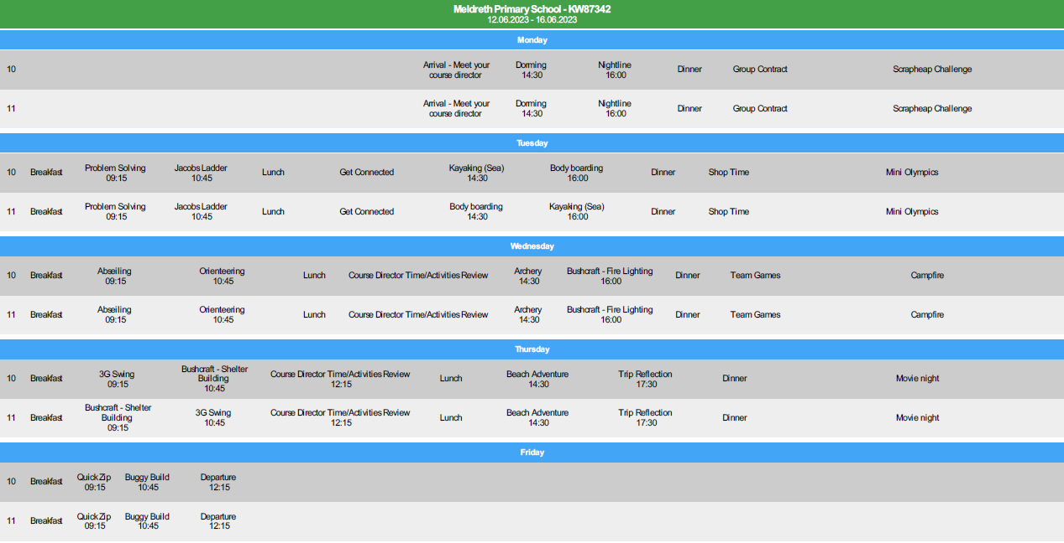

Slide 15
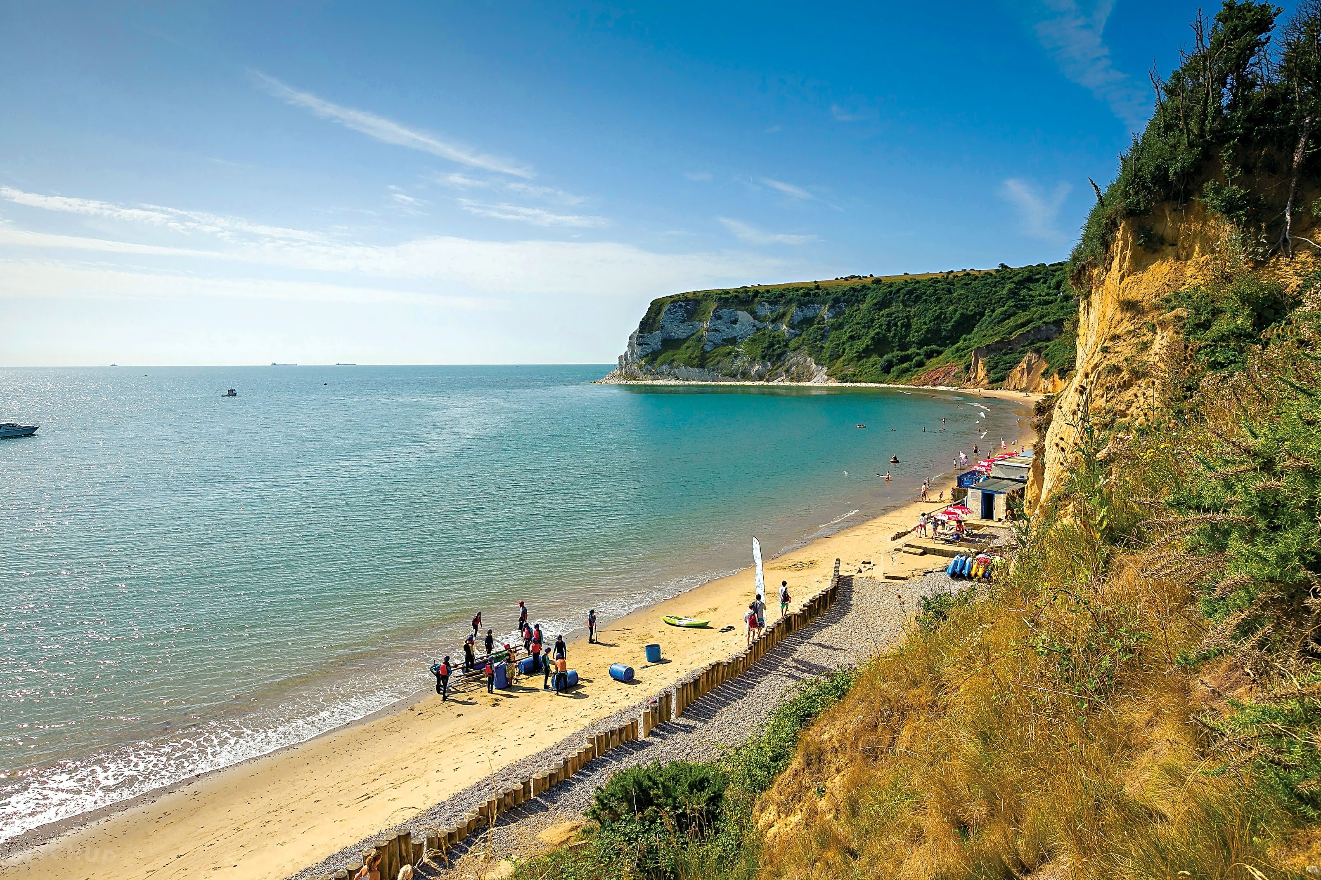

Slide 16
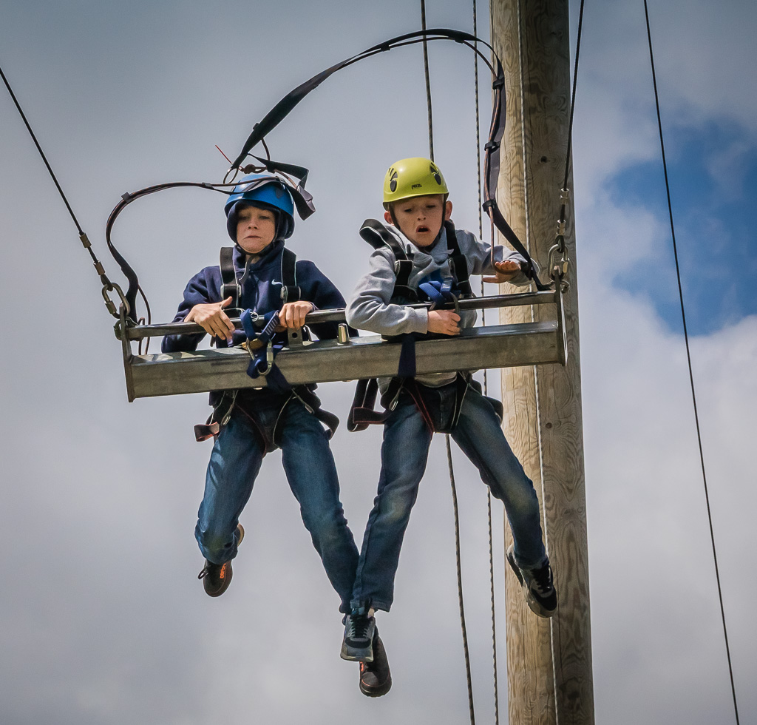

Slide 17
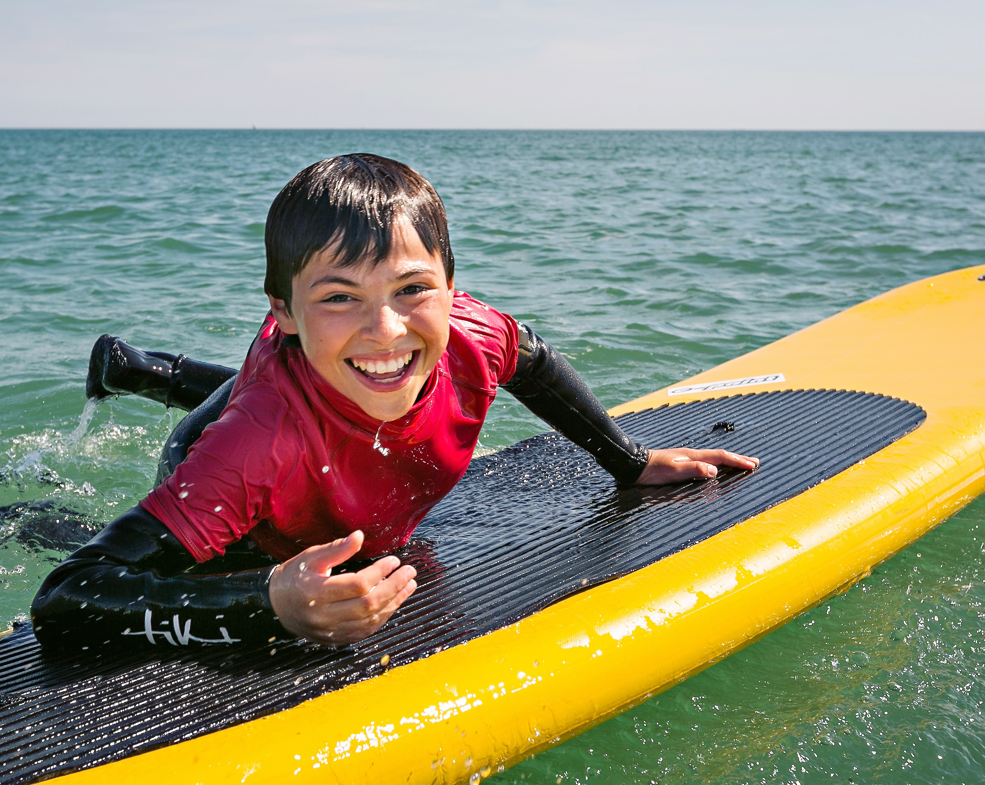

Slide 19
Relaxation Time
In between activities and in the evening, we will have a room that we can go and relax in. Here we can read books, play board games and have a catch up about our days.
Whilst inside the building, you have to bring some indoor shoes or slippers.

Slide 22
Medical requirements
Medicine in labelled container; We will provide Calpol but ask you to give us permission to give this to your child.
Any prescription medicines will be administered by staff at allocated times – you will be emailed when medicine has been given.

Slide 23
Food
Breakfast, lunch and dinner are fully catered for.
Catering staff will be aware of all dietary and allergy requirements.
Please do not pack snacks for your children.

Slide 25
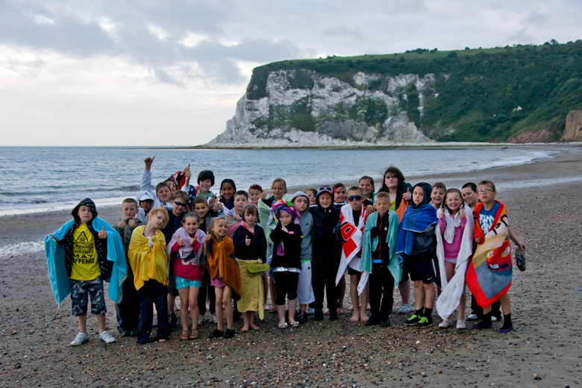
Do you have any questions?

