Slide 1
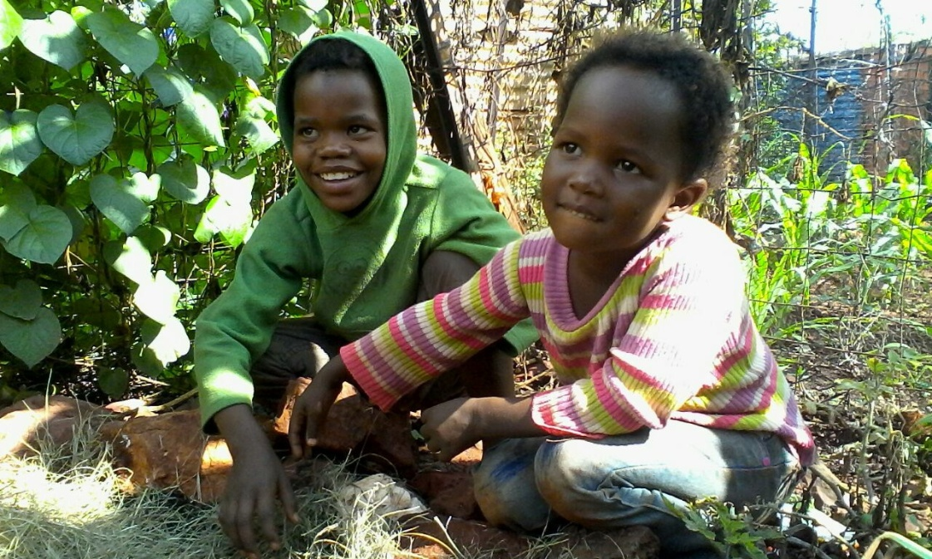
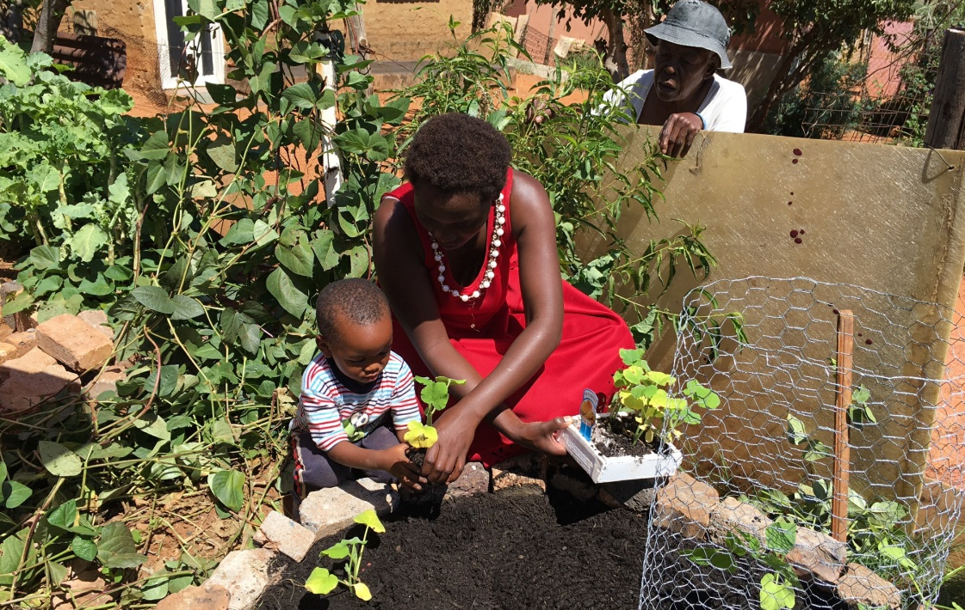
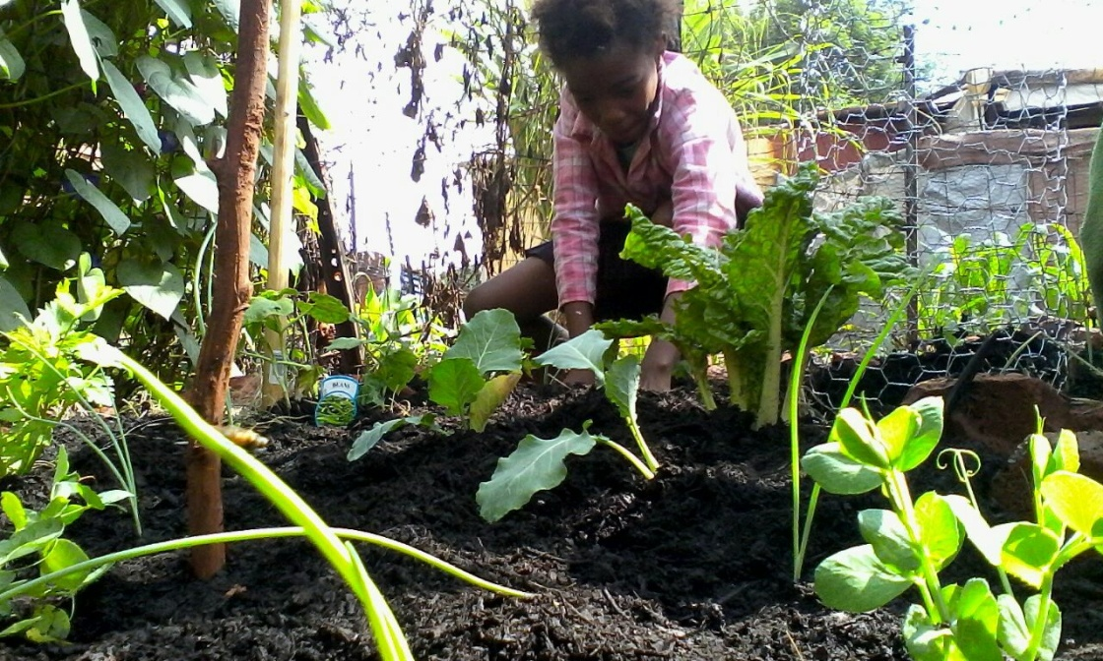
A UK Primary Schools Activity from Project HOPE UK
A strategic health initiative from Project HOPE UK

Slide 2
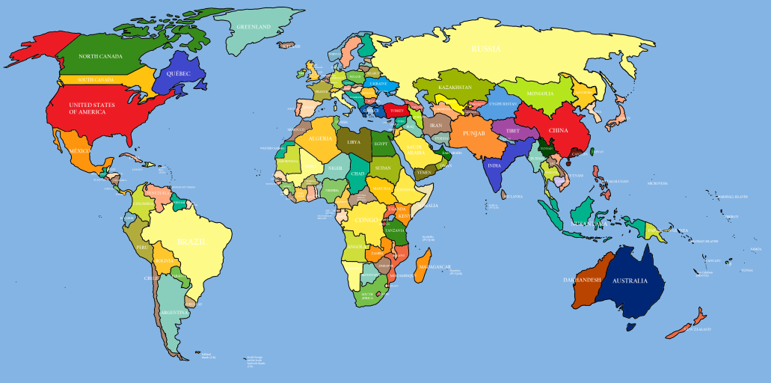
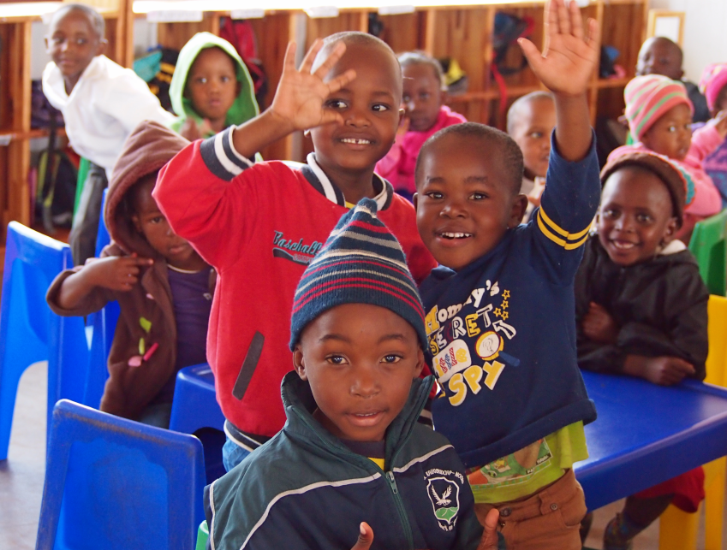
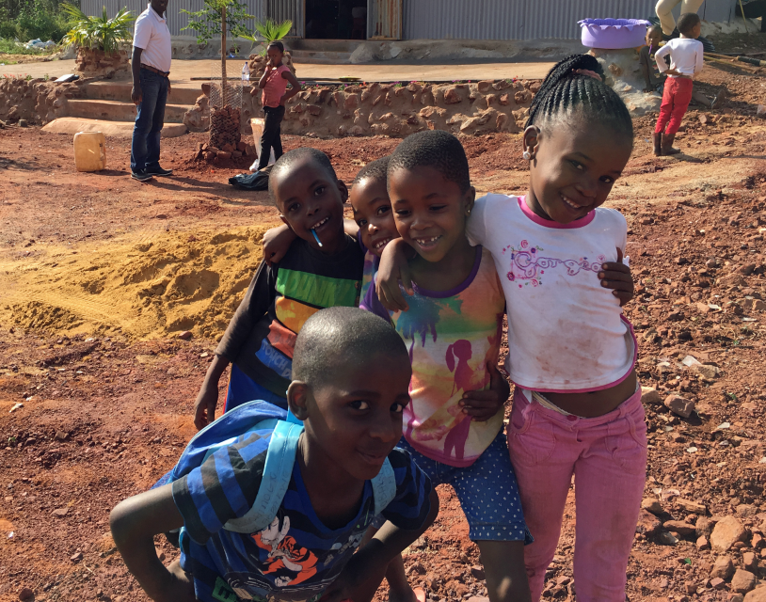
Project HOPE UK
South Africa
Project HOPE UK is a small charity which works to improve the lives of children in South Africa.
Project HOPE UK works with children and families in the poorest parts of South Africa to make sure the children there get the chance to grow up to be healthy, happy adults.

Slide 3
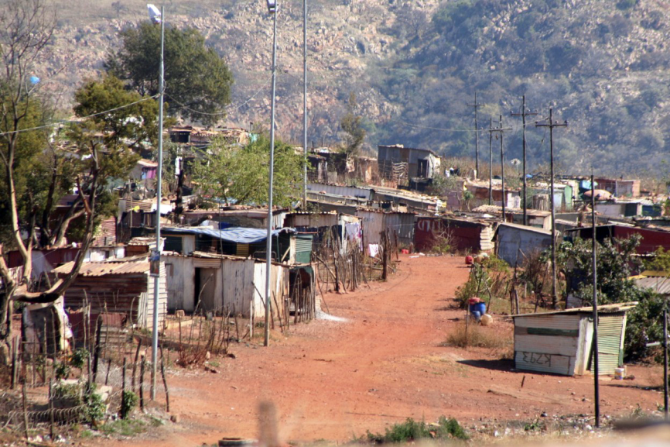
Munsieville

Slide 4
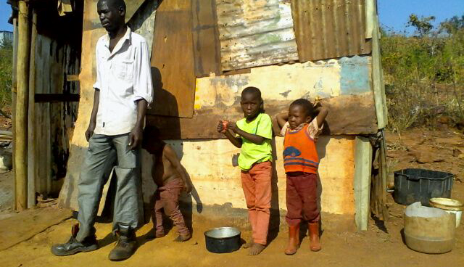

Slide 5
What happens when we don’t get enough to eat?
When we have enough of the right things to eat, we feel really good. We can run and jump and play! Eating the right food as children is important so that you can grow up to be a healthy adult.
Malnutrition occurs when we don’t eat enough of the right foods to make us healthy.
Children who are malnourished are smaller and weaker. They feel tired and get ill more often so they miss out on school. Their bones and teeth may not grow properly leading to problems when they grow up.

Slide 6
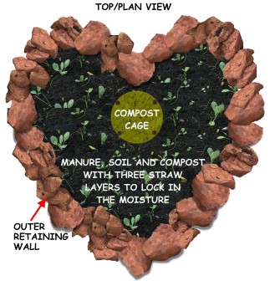
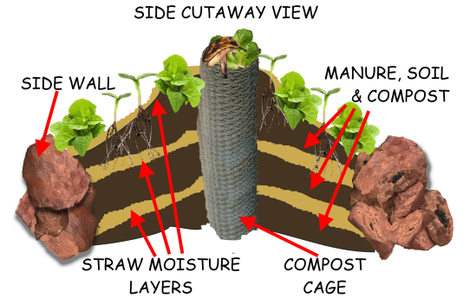
How can we help?
Project HOPE UK in Munsieville are:
1) Teaching people how to eat healthily;
2) Providing doctors and dieticians to treat people when they’re sick;
3) Helping people to grow their own healthy food with Heart Gardens.

Slide 7
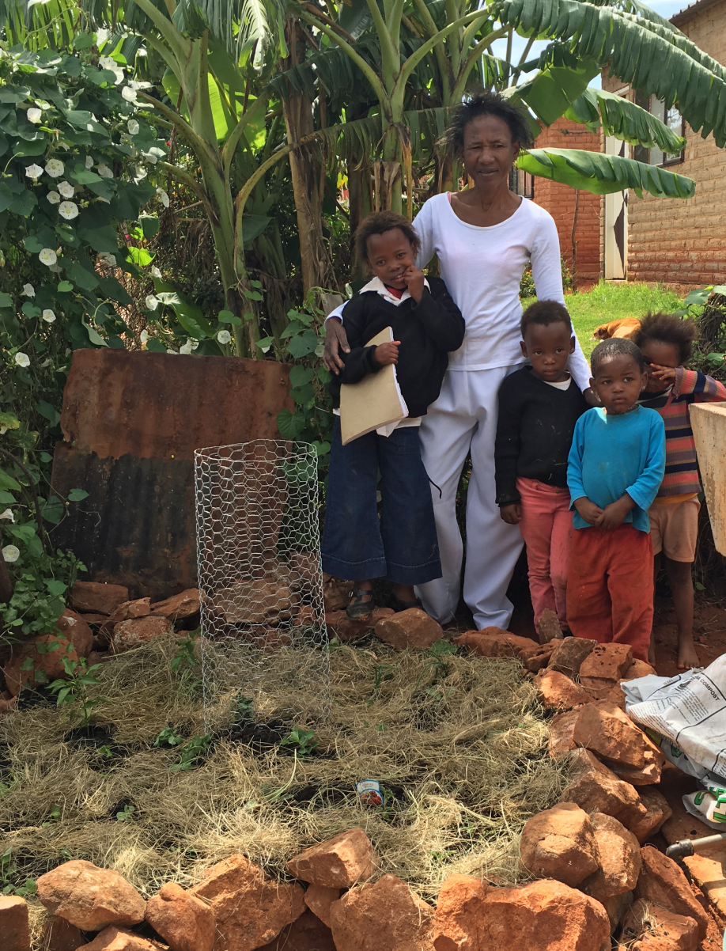
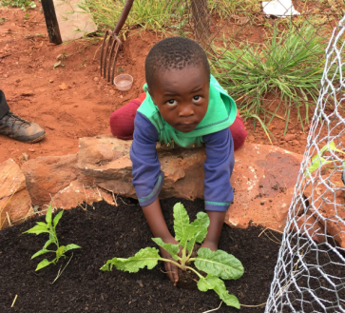
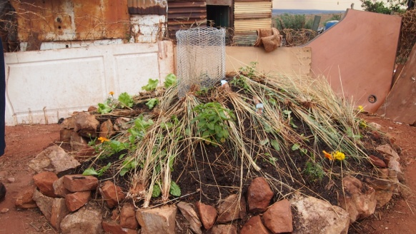
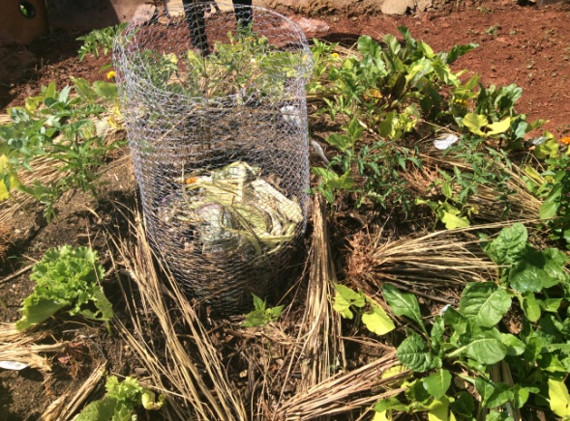
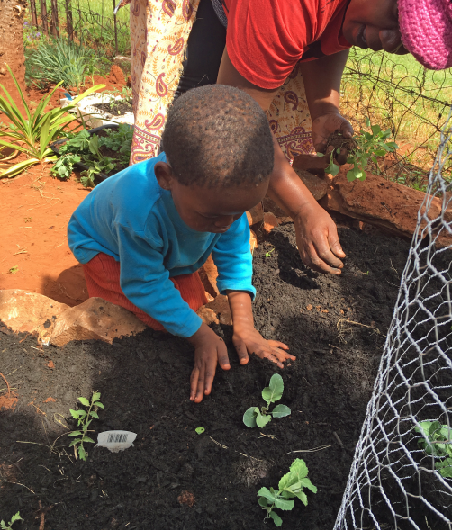
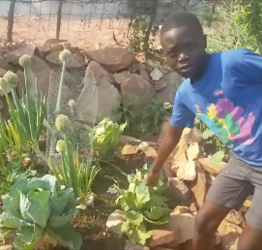
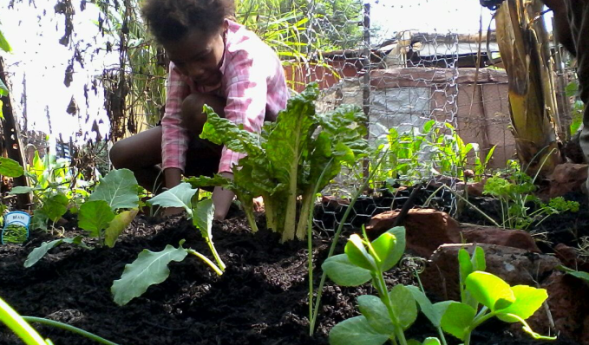
Heart Gardens in Munsieville
Some of our gardens in Munsieville ....
Click on the photo above for a short video.

Slide 8
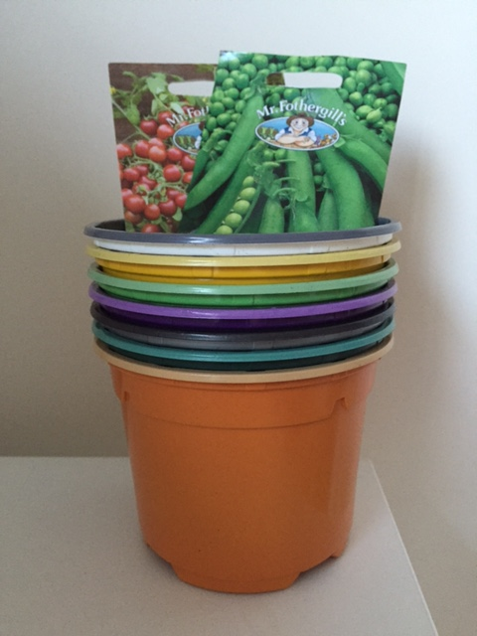
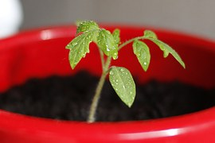
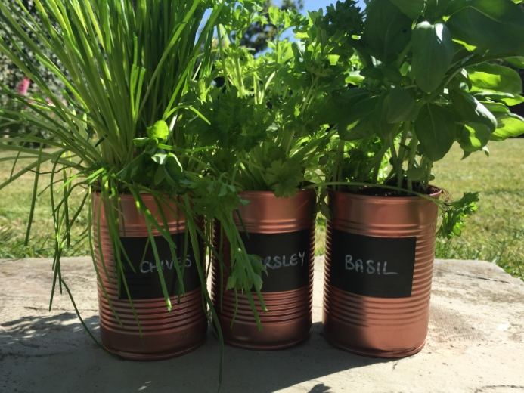
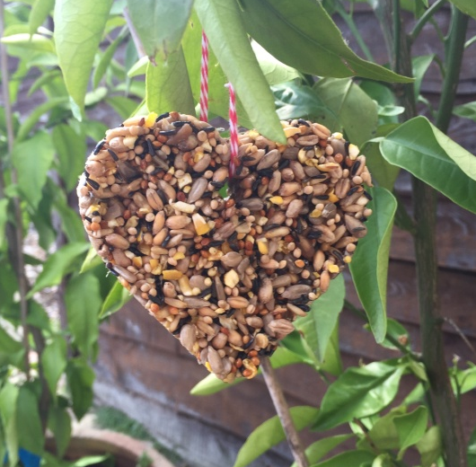
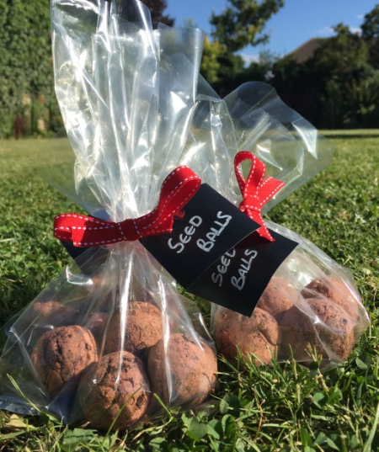
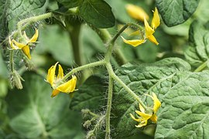
How can you help?
Get growing for You Grow-They Grow!
1) We will give your school pots, seeds and compost so that you can grow your own vegetable plants.
2) Look after your plants and learn about what makes them healthy.
3) Raise money for more heart gardens in Munsieville.
4) Find out about the gardens your money has helped to build.

Slide 9
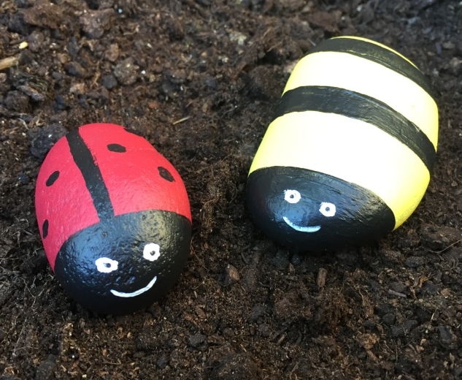
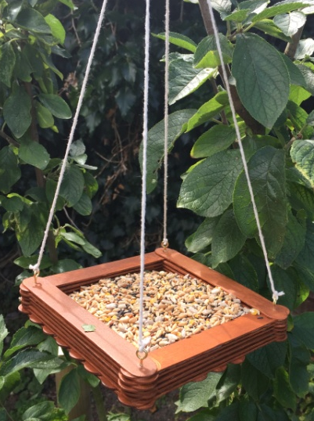
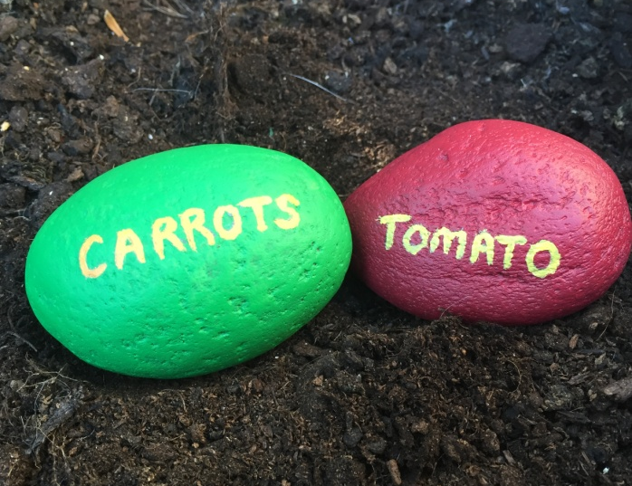
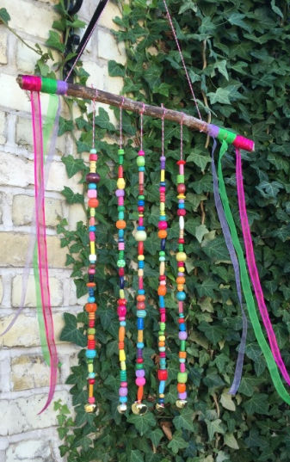
How else can you help?
Think about other things that you could make and sell

Slide 10
Any questions?
A strategic health initiative from Project HOPE UK
www.yougrowtheygrow.org/schoolsprogramme

