Slide 1
https://www.youtube.com/watch?v=56_8aK3cLEA
https://www.youtube.com/watch?v=vnR5HDfR3JI
PARENT USE ONLY
These resources should be shown to children by parents.
https://app.gonoodle.com/activities/bee-breath?s=Search&t=breathe
Bunny Breath
https://app.gonoodle.com/activities/rainbow-breath?s=Search&t=breathe
https://app.gonoodle.com/activities/bubble-breath?s=Search&t=breathe
https://app.gonoodle.com/activities/swirling?s=Search&t=breathe
https://app.gonoodle.com/activities/take-a-breath?s=category&t=Manage%20Stress&sid=22
https://app.gonoodle.com/activities/find-joy-1?s=Channel&t=Think%20About%20It&sid=17&cs=think-about-it
https://app.gonoodle.com/activities/how-to-make-a-squishy-stress-ball?s=category&t=Manage%20Stress&sid=22
https://app.gonoodle.com/categories/stretch
How To Draw Archives

Slide 2
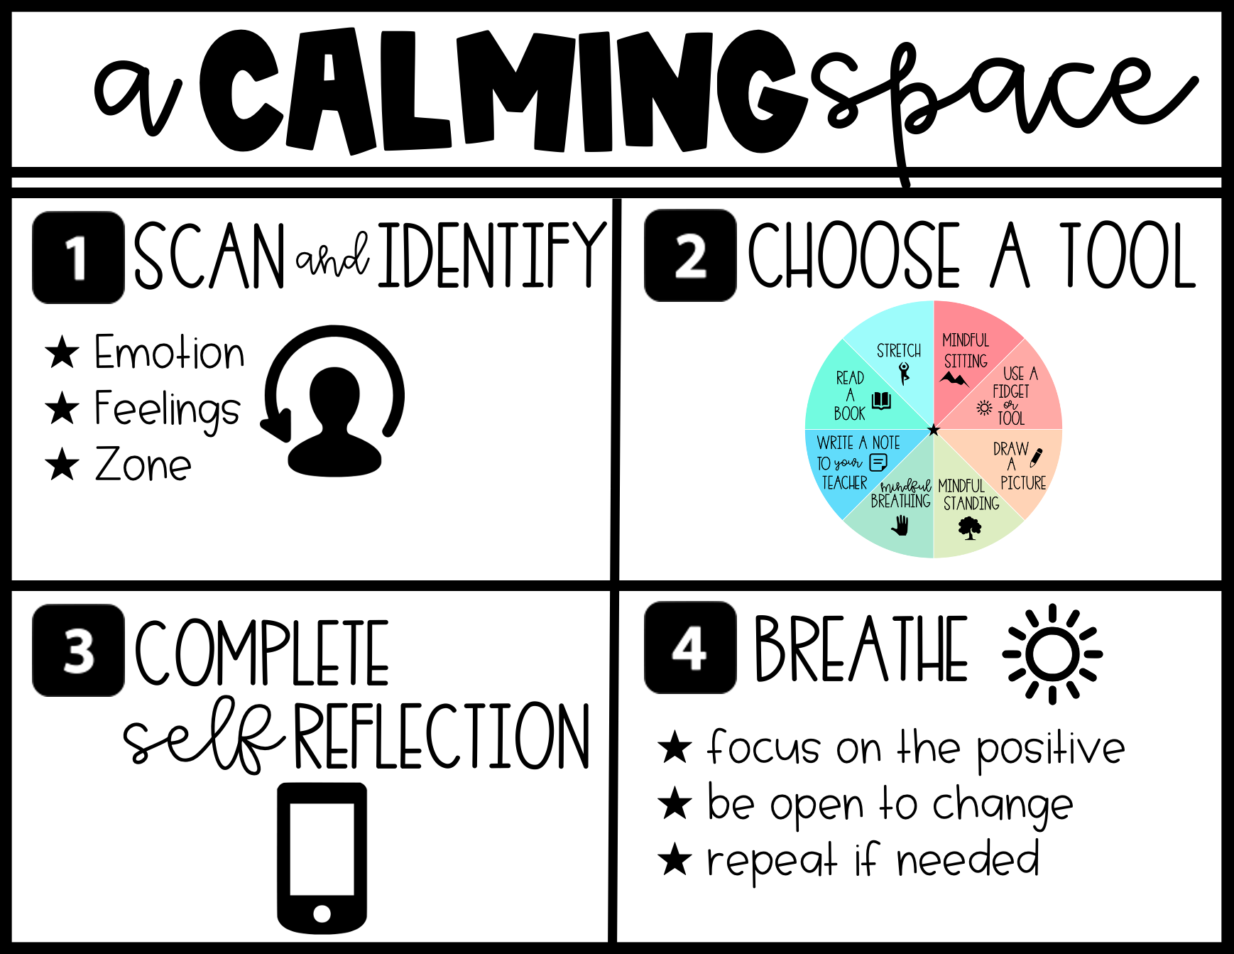

Slide 3
